Slide 1
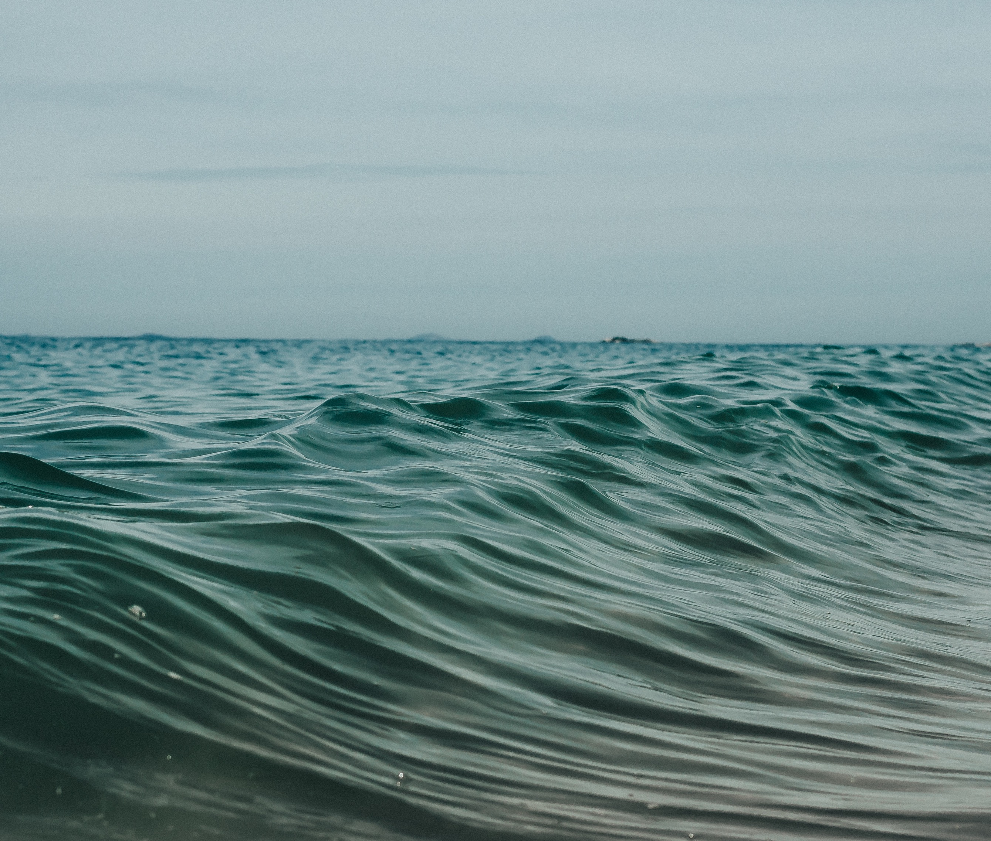

WELCOME TO SEASON OF CREATION | 2026
Uniting Church in Australia

Slide 2

INSERT SONG #1 TITLE HERE
(a song of praise) Insert song lyrics here

Slide 3
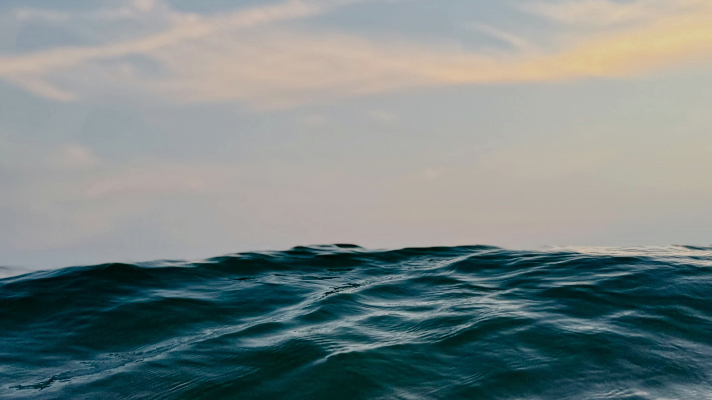
ACKNOWLEDGEMENT OF COUNTRY

Slide 4

OPENING PRAYER
Insert the Psalm of the day here

Slide 5
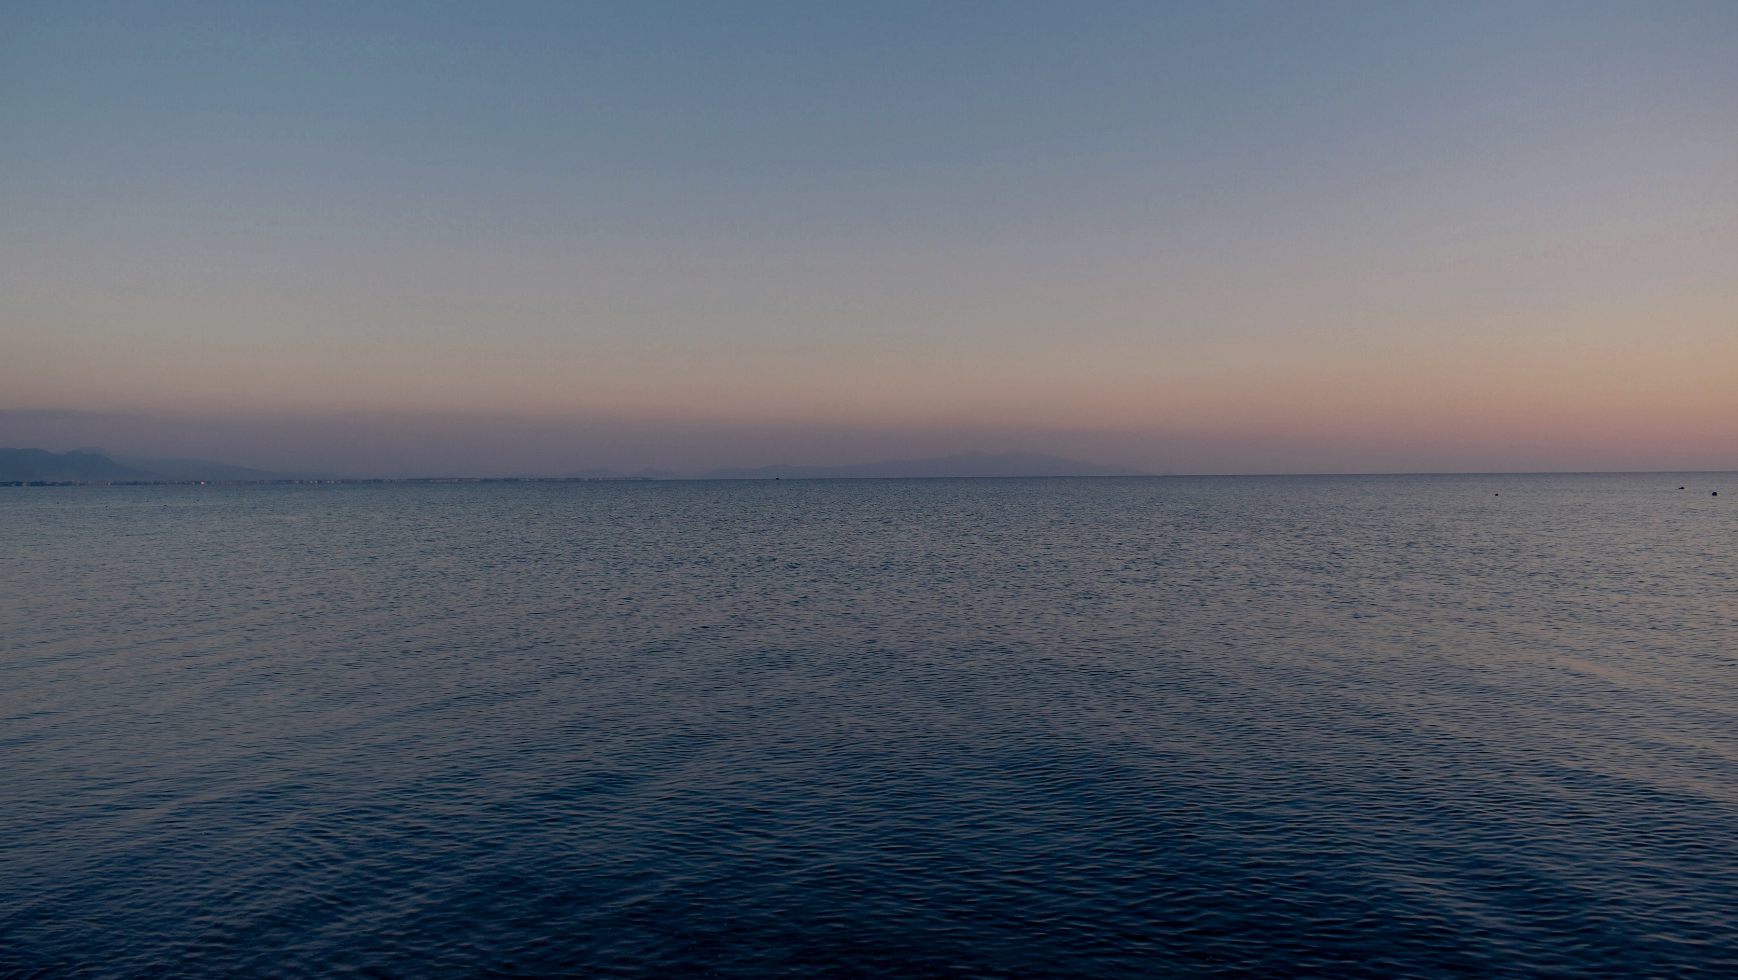
PRAYER FOR THE SEASON
Holy God, whose Spirit hovered
over the waters at the beginning,
we gather as part of your community
of all creation, thirsty for your grace.
We give thanks for the gift of water,
the veins of our common home,
that sustains the cedar and the whale,
the pasture and the city.

Slide 6
We are grateful for the local waters
that nourish our homelands
and our fellow creatures.
We give thanks
that in your well-watered garden,
every drop is a sacred testament
to your love.

Slide 7

God, you are merciful
God, you are merciful
Christ, you are merciful
Christ, you are merciful
God, you are merciful
God, you are merciful
Amen.

Slide 8
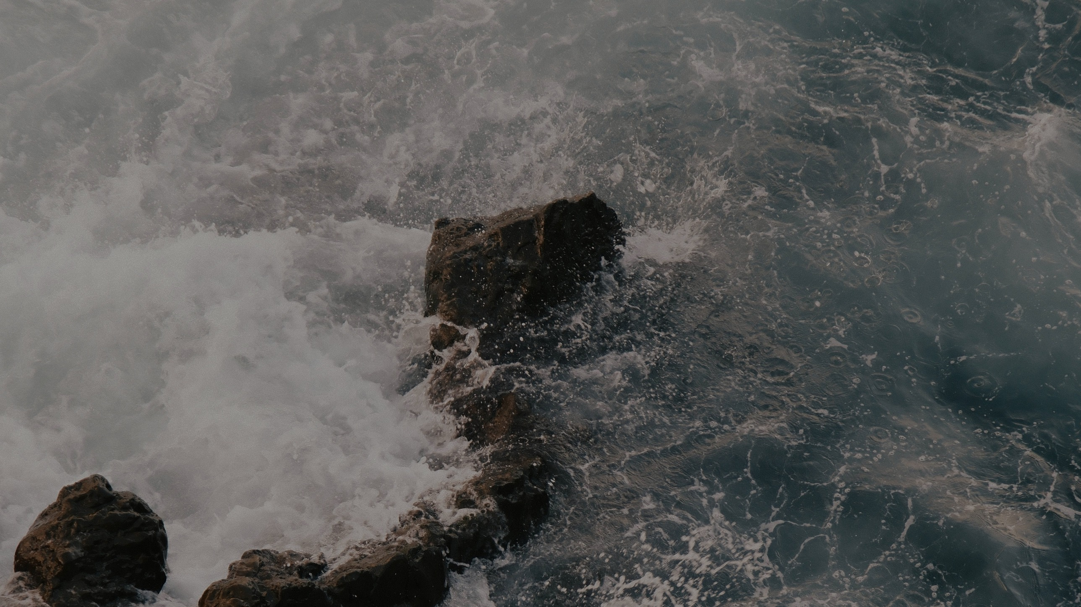
INSERT SONG #2 TITLE HERE
(A SONG OF ILLUMINATION)
Insert song lyrics here

Slide 9

CONTEMPORARY WITNESS

Slide 10
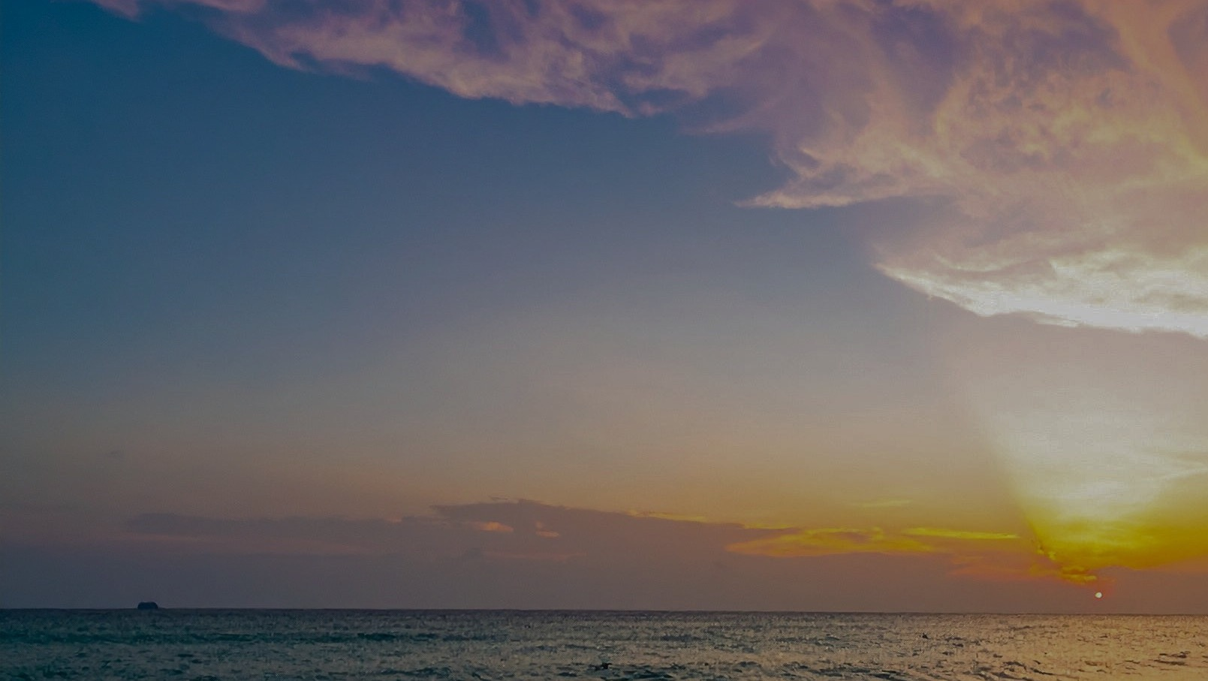
SCRIPTURE READINGS
Insert Bible passages to be read here

Slide 11
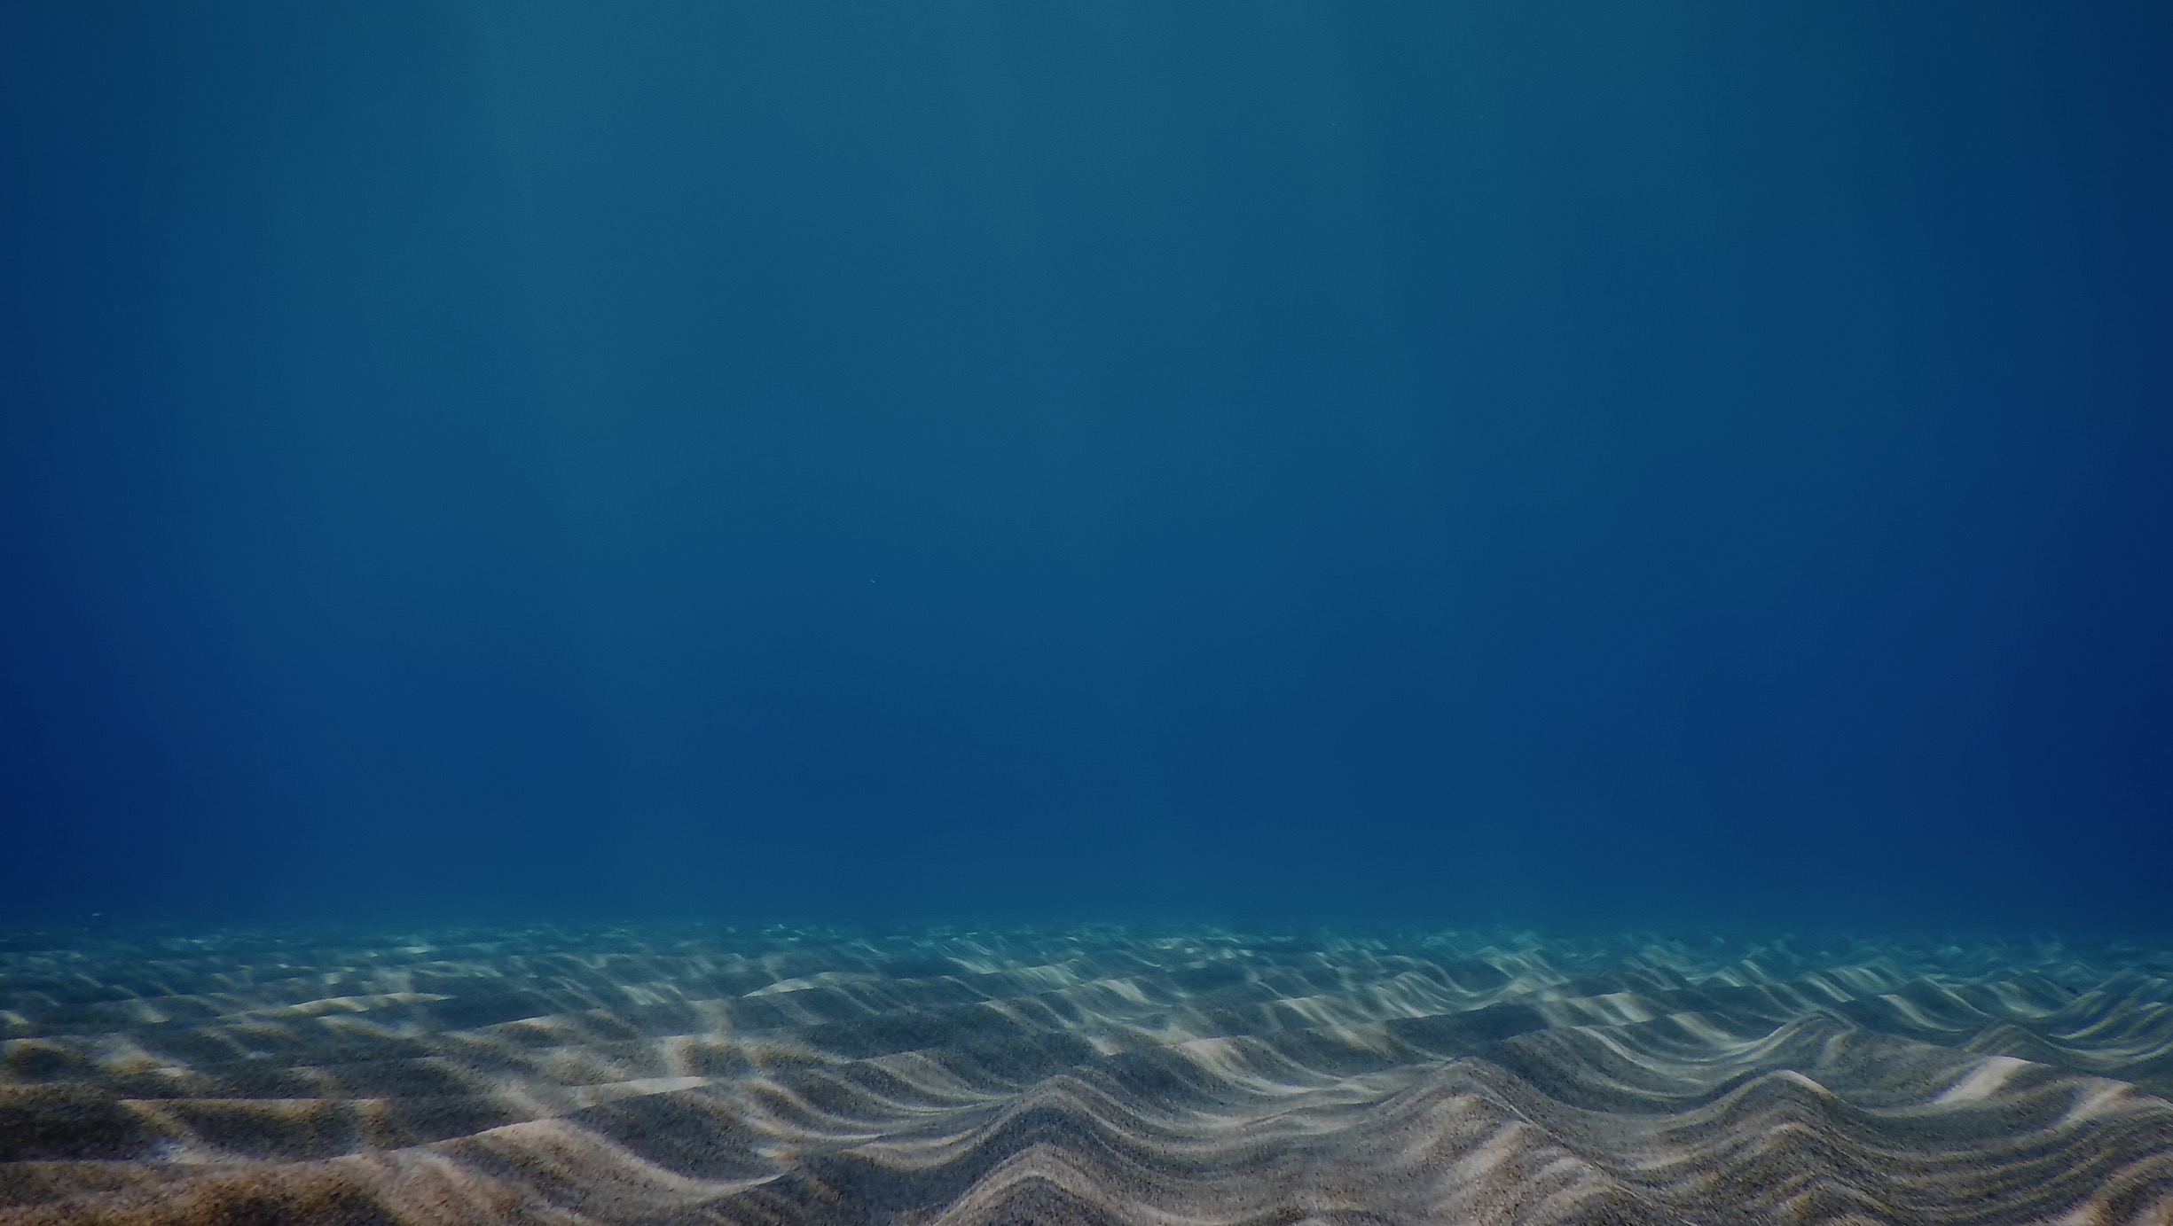
PREACHING

Slide 12
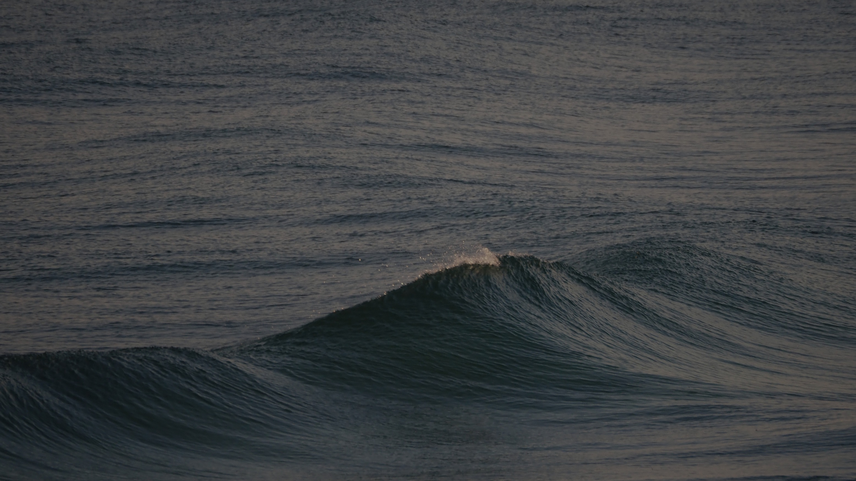
RESPONSE OF FAITH
We believe in God,
who creates all things,
who embraces all things,
who celebrates all things,
who is present in every part
of the fabric of creation.
We believe in God
as the source of all life,
who baptises this planet
with living water.

Slide 13
We believe in Jesus Christ,
seen in the suffering one,
the poor one,
the malnourished one,
the climate refugee -
who loves and cares for this world
and suffers with it.
And we believe in Jesus Christ,
the seed of life,
who came to reconcile
and renew this world
and everything in it.

Slide 14
We believe in the Holy Spirit,
the breath of God,
who moves with God
and who moves among
and with us today.
We believe in everlasting life in God.
And we believe in the hope
that one day God will put an end
to death and all destructive forces.

Slide 15
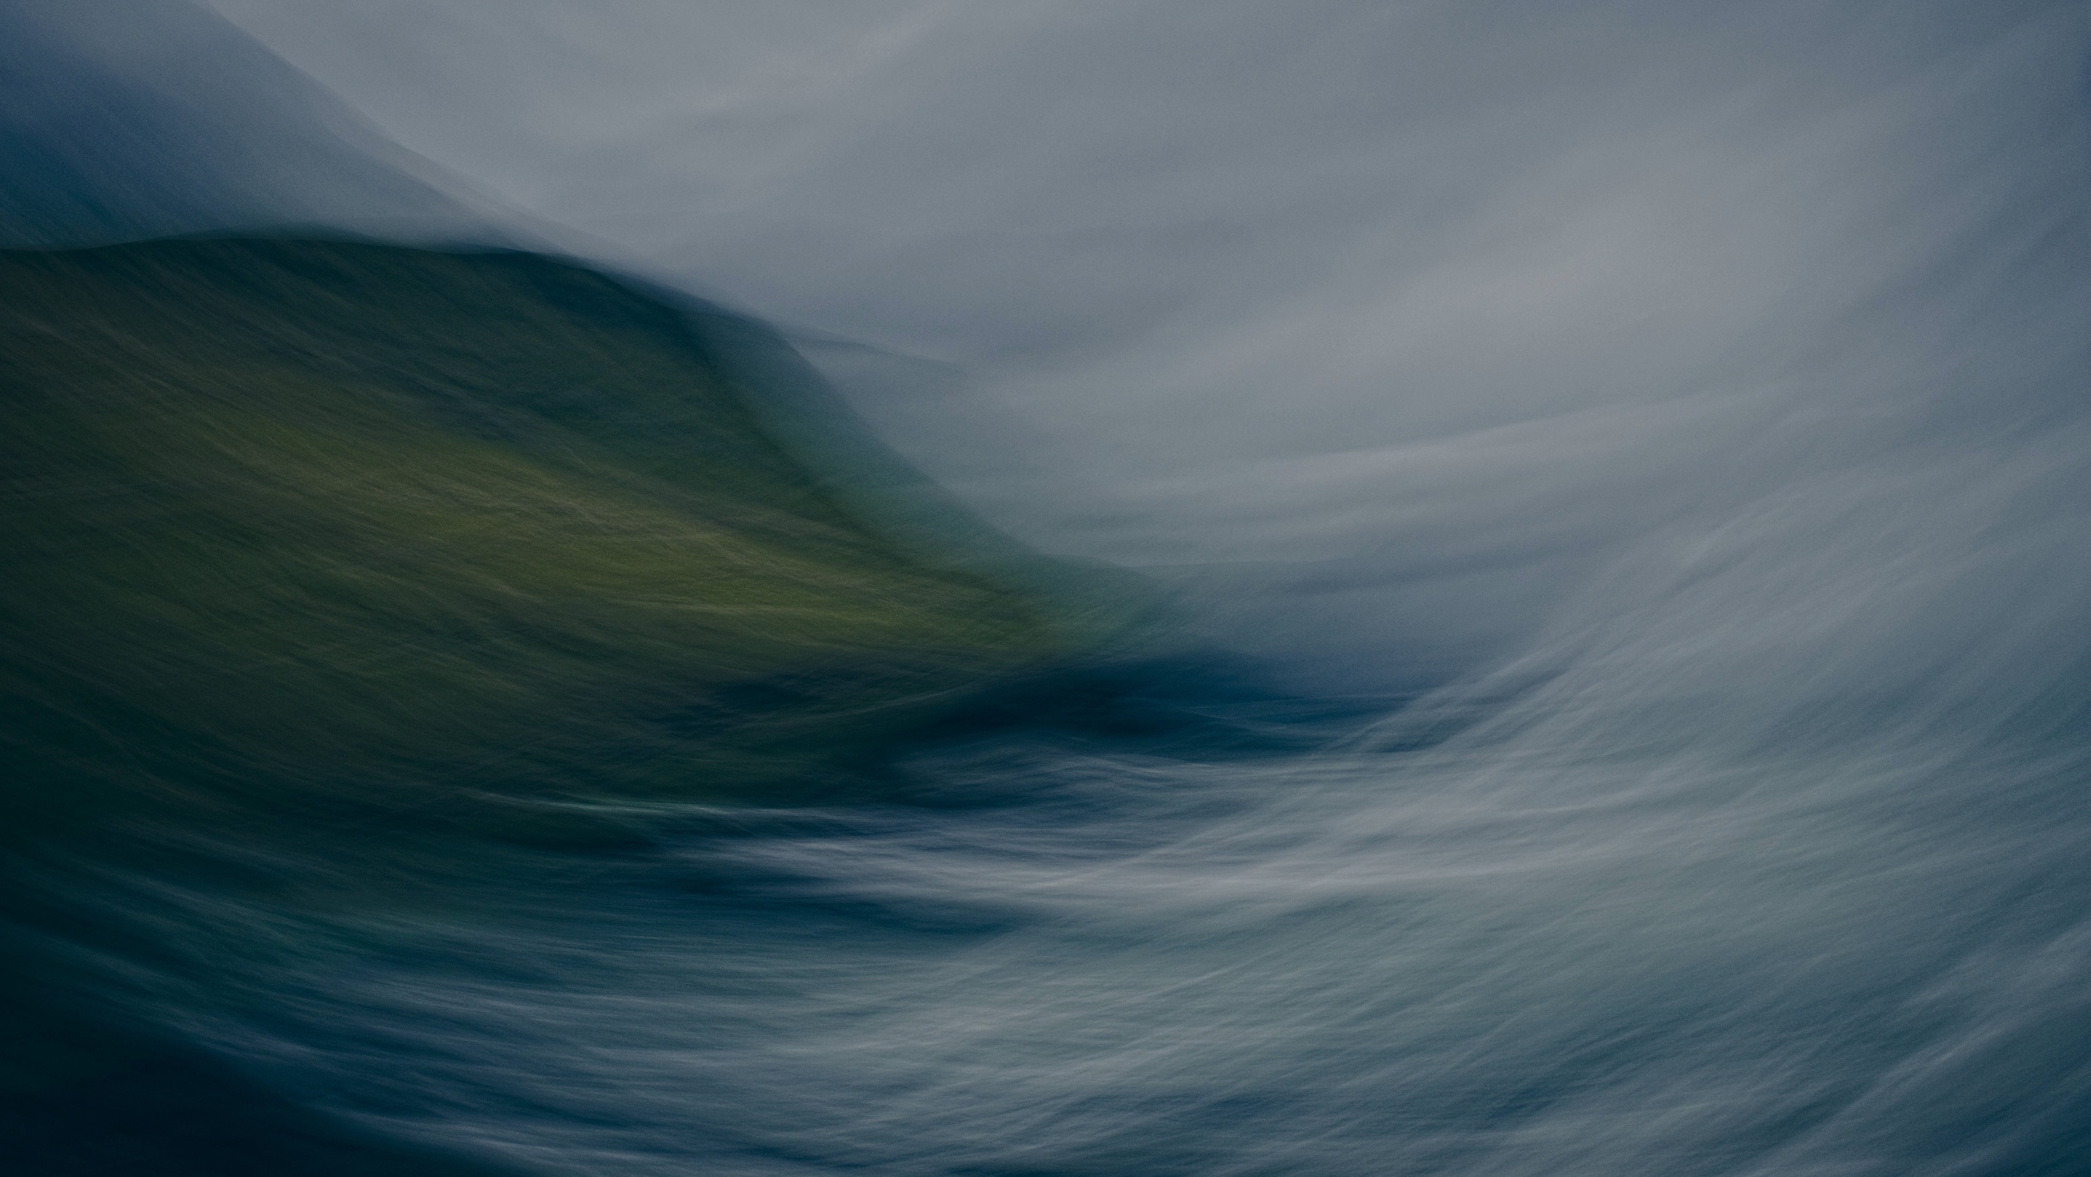
NOTICES AND OFFERING

Slide 16
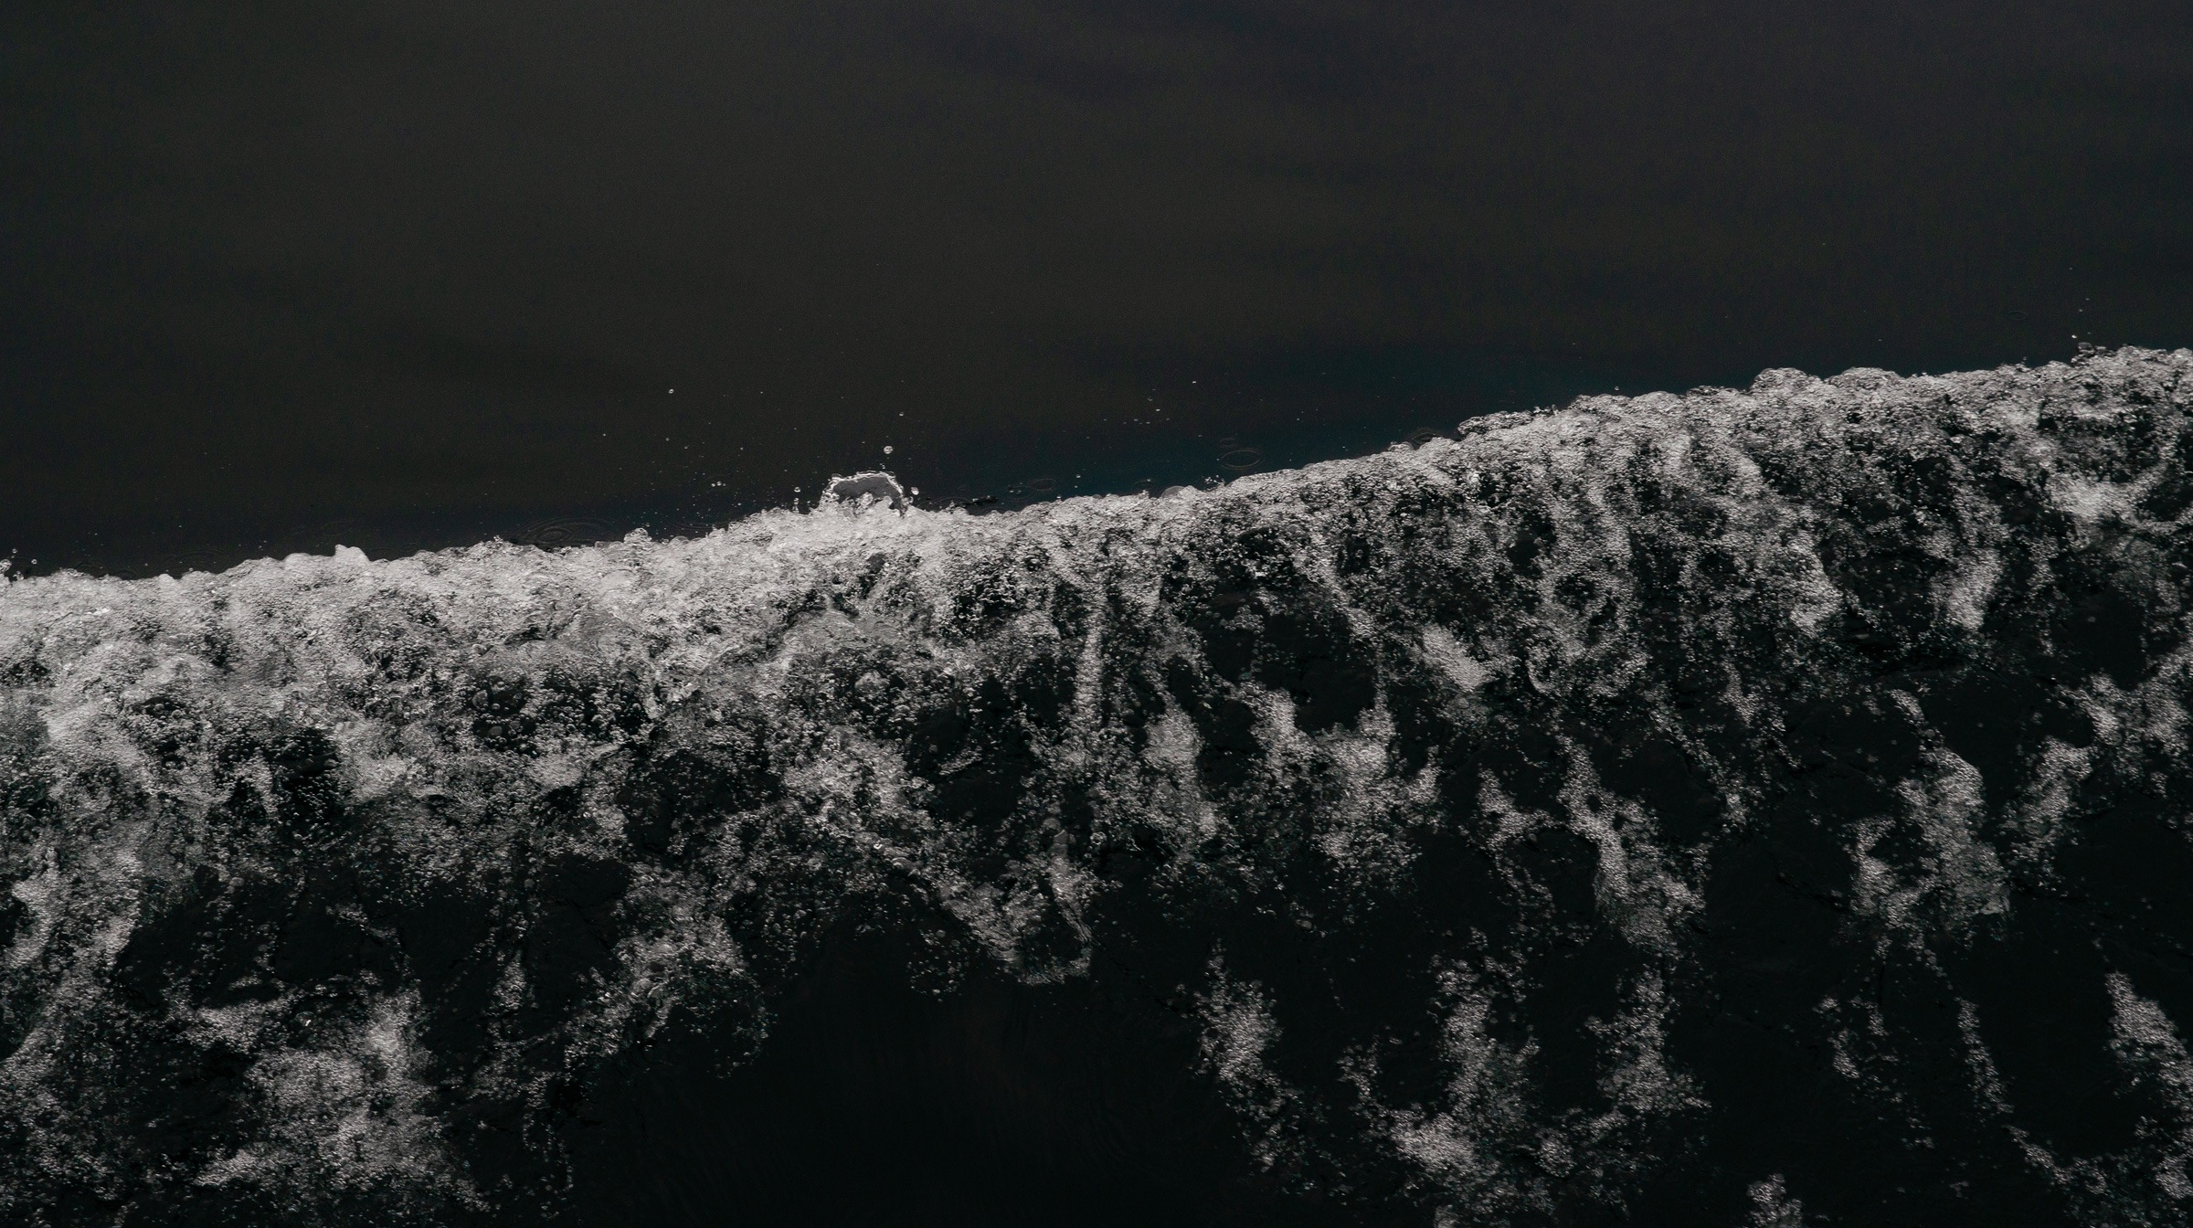
PRAYERS

Slide 17
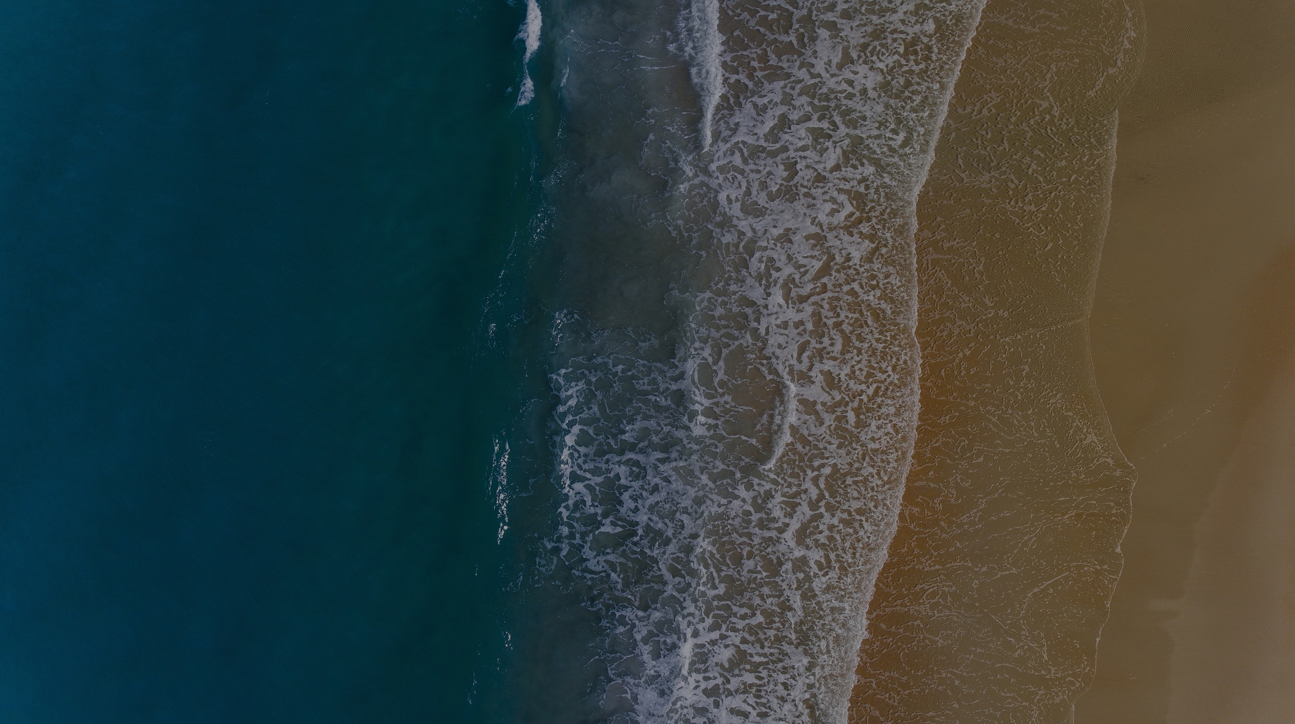
THE LORD’S PRAYER
Our Father in heaven,
hallowed be your name,
your kingdom come,
your will be done,
on earth as in heaven.
Give us today our daily bread.

Slide 18
Forgive us our sins
as we forgive those who sin against us.
Save us from the time of trial
and deliver us from evil.
For the kingdom, the power,
and the glory are yours
now and for ever.
Amen.

Slide 19
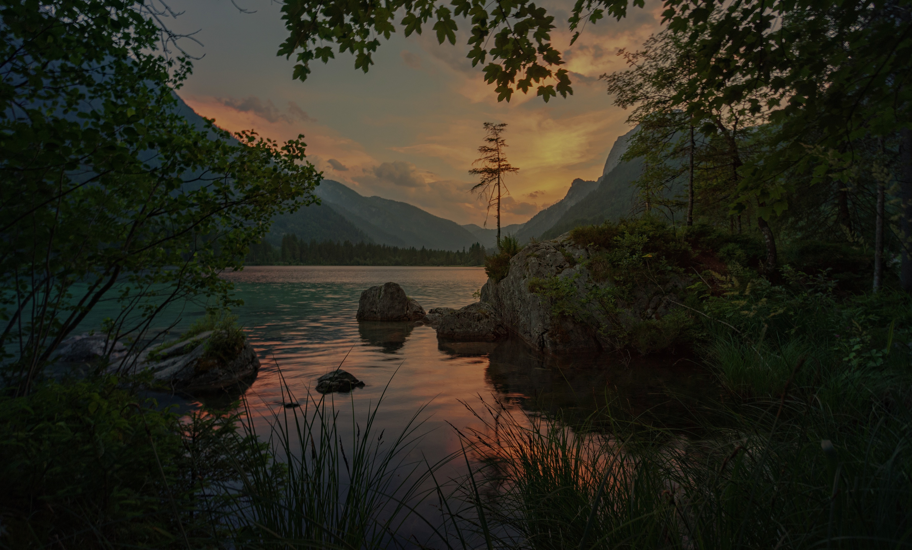
THANKSGIVING

Slide 20

SENDING

Slide 21
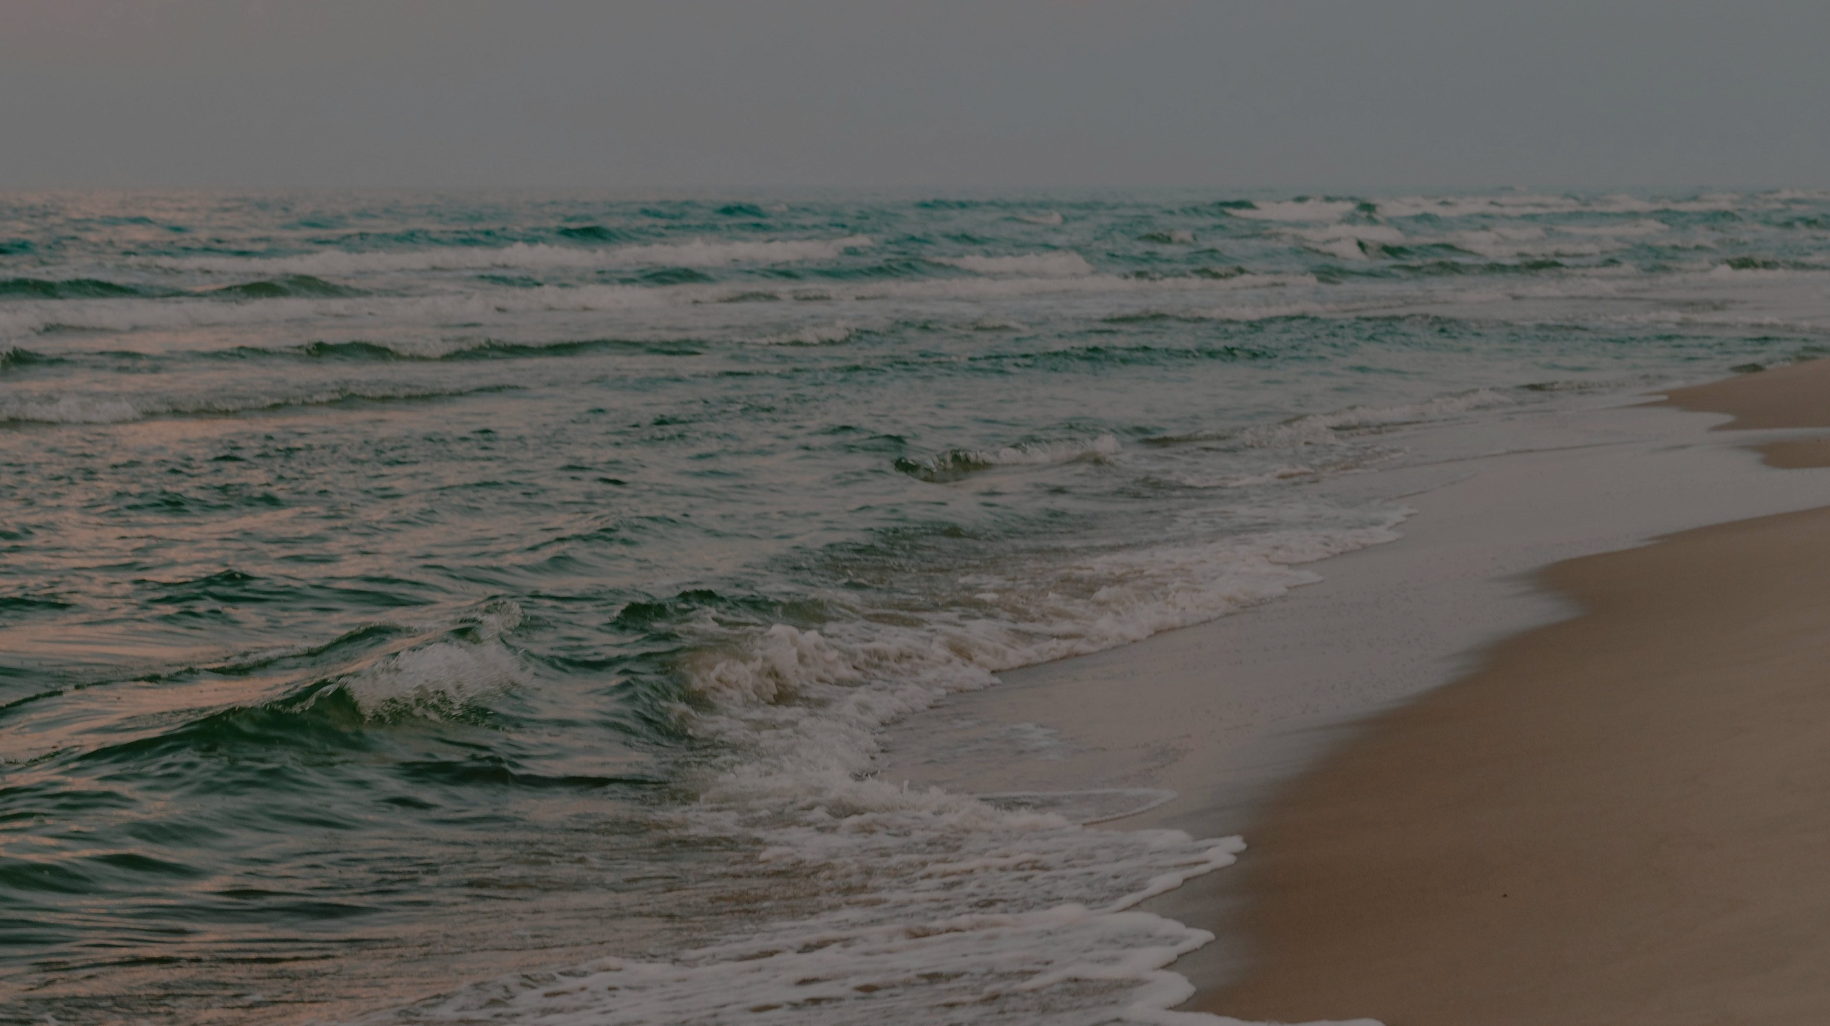
INSERT SONG #3 TITLE HERE
(A SONG OF SENDING)
Insert song lyrics here

Slide 22
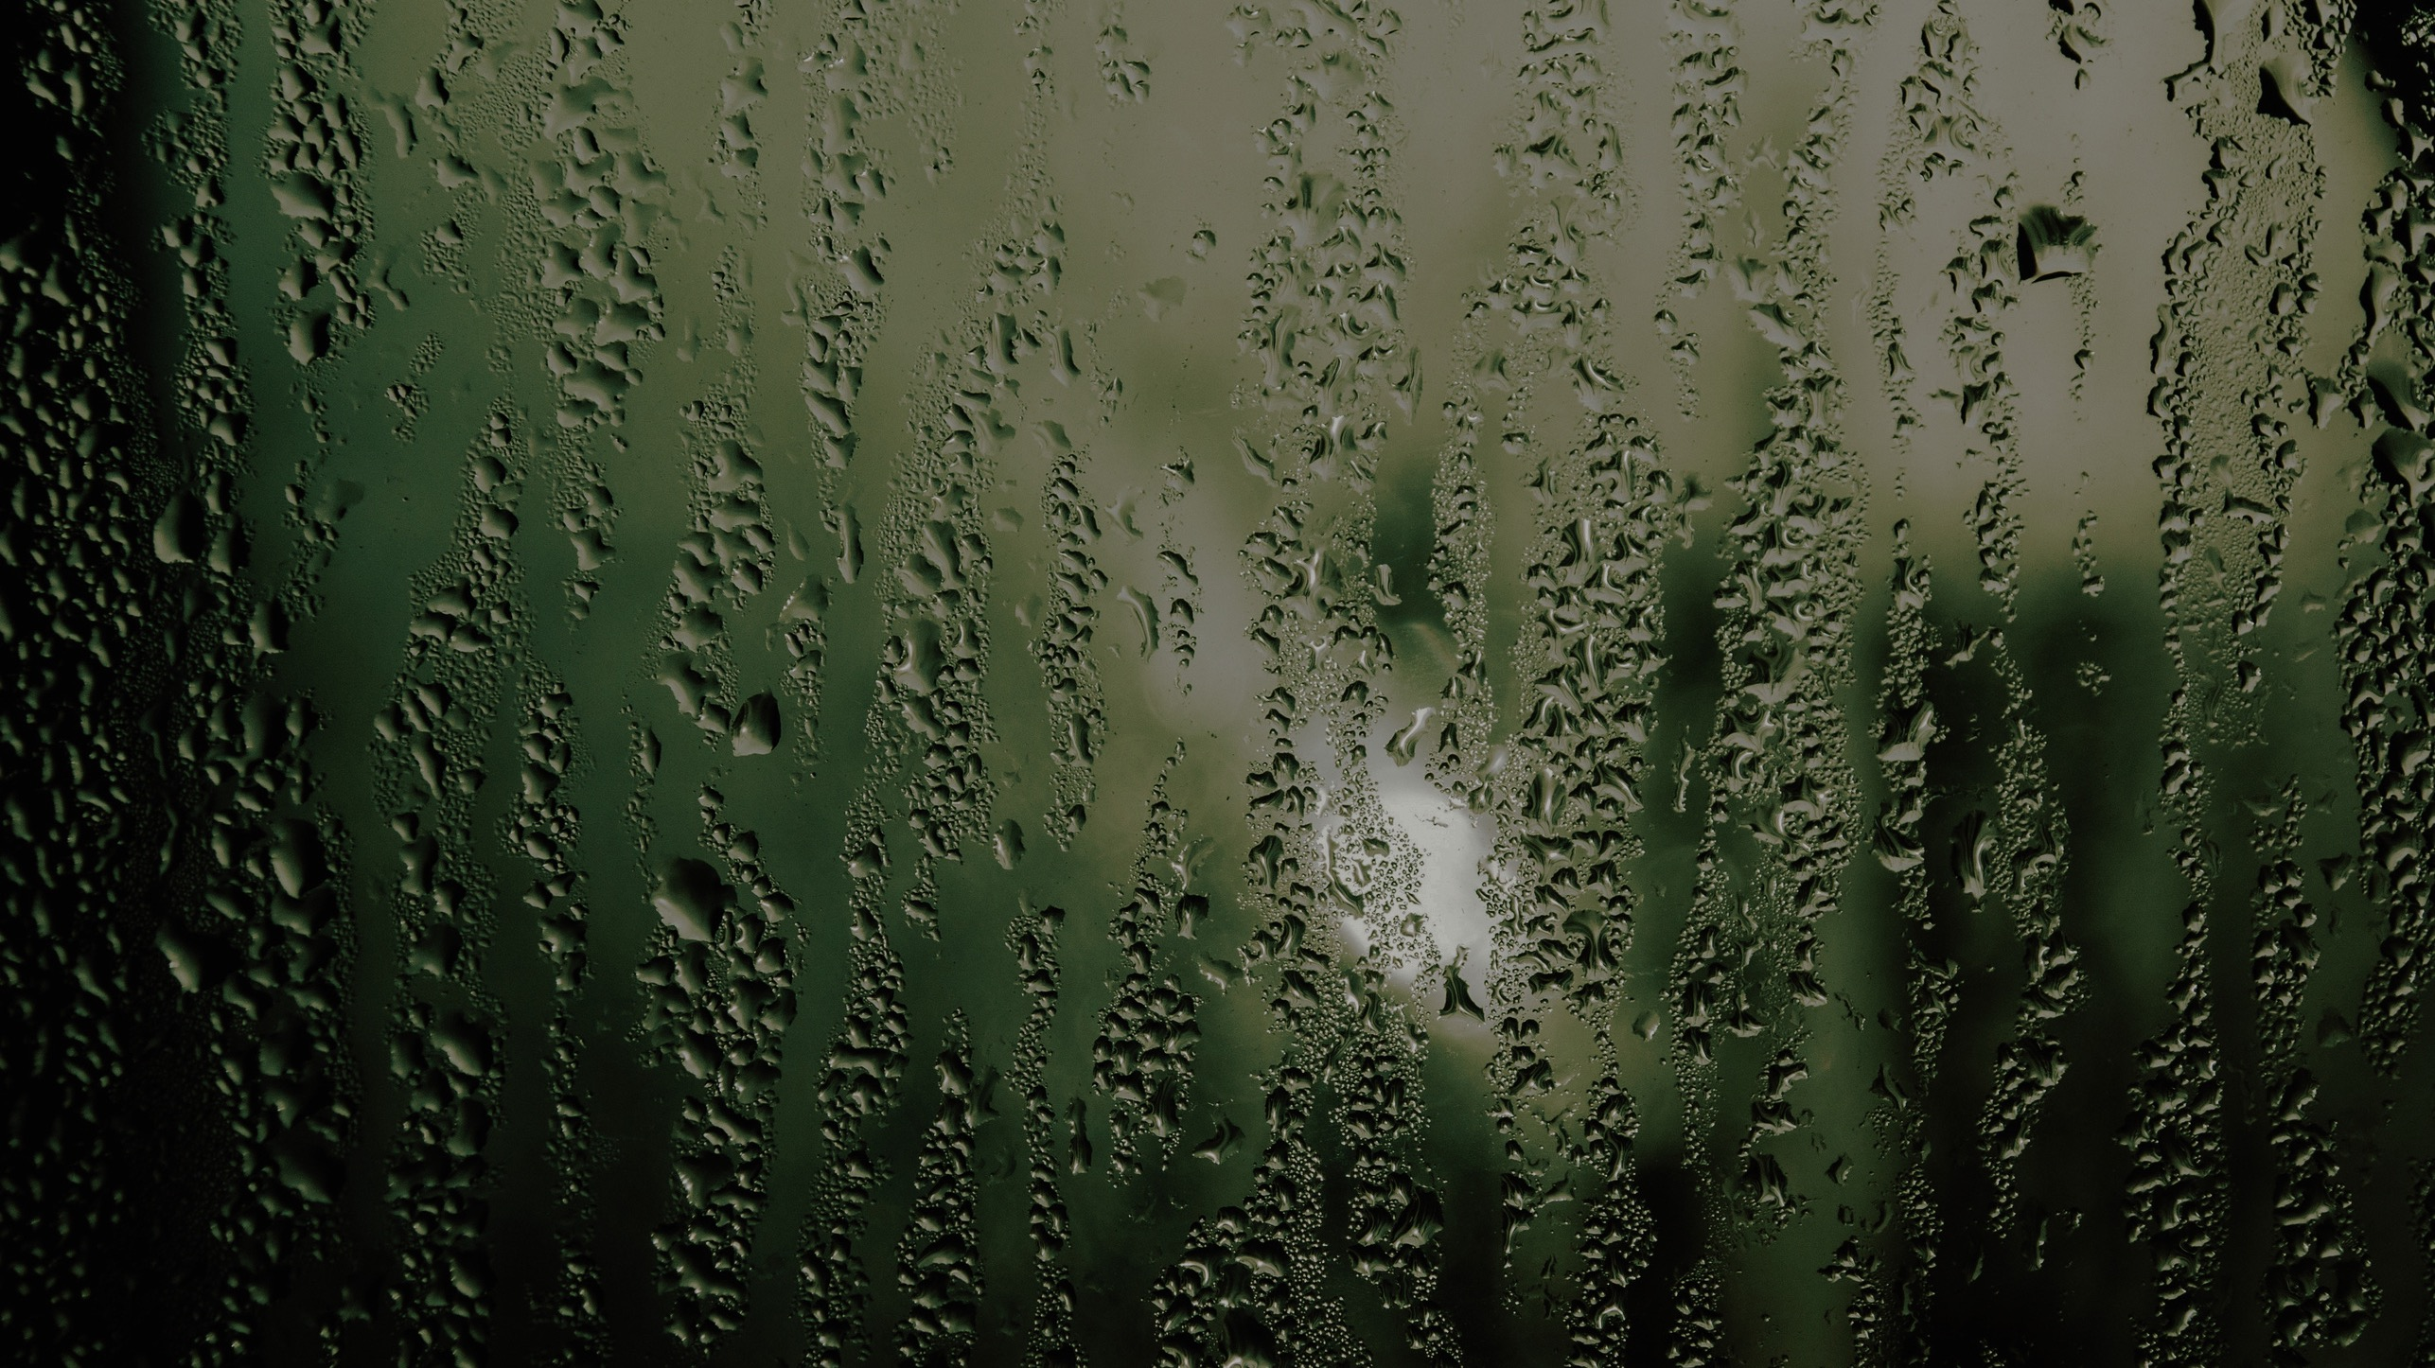
BLESSING AND SENDING

Slide 23
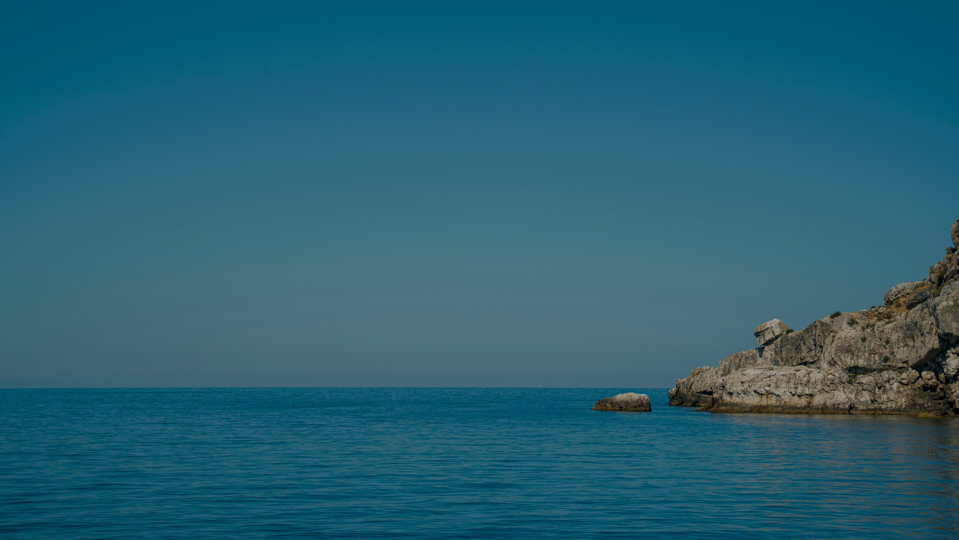
THE PEACE

